Slide 1
Welcome
to the
Training Session
on
Problem Solving Techniques

Slide 2
Measurement
Agenda
Introduction
Types and Sources of Problem
Problem Definition
Analytical Techniques for Problem Identification
Analysis of Root Cause
Implementation of Actions
Standardization and Sustenance of Results
Case Studies / Group Exercises

Slide 3
Measurement
Measurement
Easy to Measure
Need to Measure

Slide 4
Measurement
Measurement as per ISO 9001:2008
Customer Satisfaction
System Measure
Process Measure
Product Measure

Slide 5
Measurement
Measurement has no meaning without targets
Management
Competition
Target Setters
Customer
Self

Slide 6
Customer Satisfaction
The Organization shall monitor information related to
    Customer Perception
    Meeting Customer Requirements
    Methods for obtaining customer requirements
    Methods for using the above information
REQUIREMENTS

Slide 7
Internal Audit
Conduct Internal Audits at planned intervals to -
    Conform to planned arrangements
    Quality Management System Requirements
    Ensure implementation is effective
REQUIREMENTS

Slide 8
Monitoring & Measurement of Process
Apply suitable methods for
    Monitoring and Measuring
    To measure QMS Processes
    Demonstrate ability of above to points to achieve planned results
REQUIREMENTS

Slide 9
Process Measure
Process Measure
Measuring Effectiveness
Measuring Efficiency

Slide 10
Input
Monitoring & Measuring opportunities
Procedure
Process
(“Specified way to carryout an activity or a process”-may be documented or not)
(Before, During & After the Process)
Output
Effectiveness of process
(Ability to achieve
desired results)
Efficiency of process
(Results achieved
v/s.
Resources used)

Slide 11
Monitoring & Measurement of Product
Monitor and Measure
    The characteristics of the product to meet product requirements
    Carry out the process at appropriate stages
    Is in accordance with planned arrangements
REQUIREMENTS

Slide 12
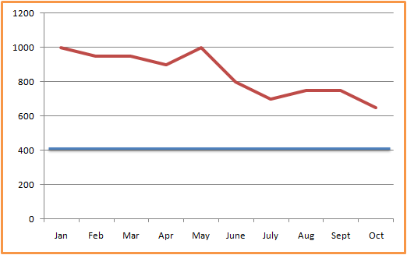
Non – Conformity (NC) / Problem
Means
Non – Fulfillment of a Requirement
Gap between desired and actual level of performance
Actual
Target

Slide 13
Sources of Non Conformity
Planning for Product Realization
Failure to Meet Quality Objectives
Failure to Meet Product Requirements

Slide 14
Sources of Non Conformity
Failure to Meet Objectives
Improper Feasibility Review
Customer Related Process
Incomplete Review
Untimely Review

Slide 15
Sources of Non Conformity
Design Process
Design Validation Failure
Design Verification Failure

Slide 16
Sources of Non Conformity
Purchasing
Receipt Product Quality
Failure to Meet Delivery Schedule

Slide 17
Sources of Non Conformity
Production Process
Non-Conforming Product
Breakdowns
Unstable Process
Incapable Process
Accident

Slide 18
Sources of Non Conformity
Customer Satisfaction
Periodic Rating
Customer Feedback
Customer Complaints ?

Slide 19
Sources of Non Conformity
Internal Audit
System NC

Slide 20
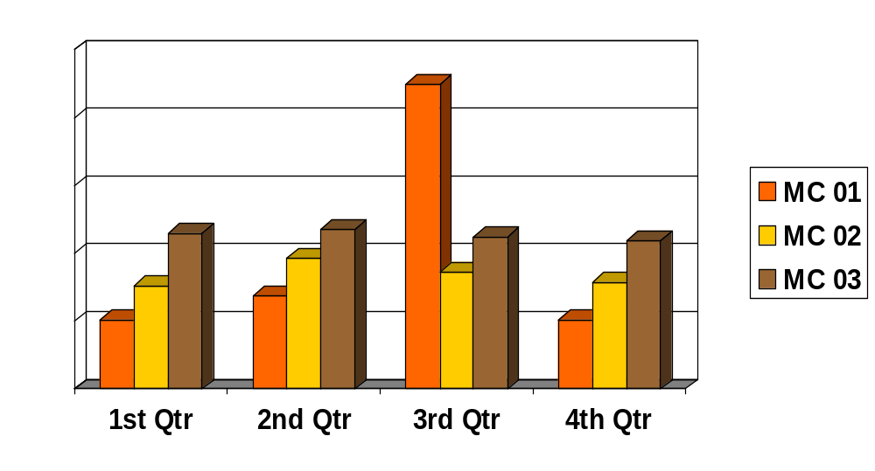
Sporadic Problem
Types of Problems

Slide 21
Sporadic Problem
Types of Problems
Occasionally occurring
Generally causes are known
immediately
Immediate solutions are provided
Corrective actions are taken to
bring it to existing level

Slide 22
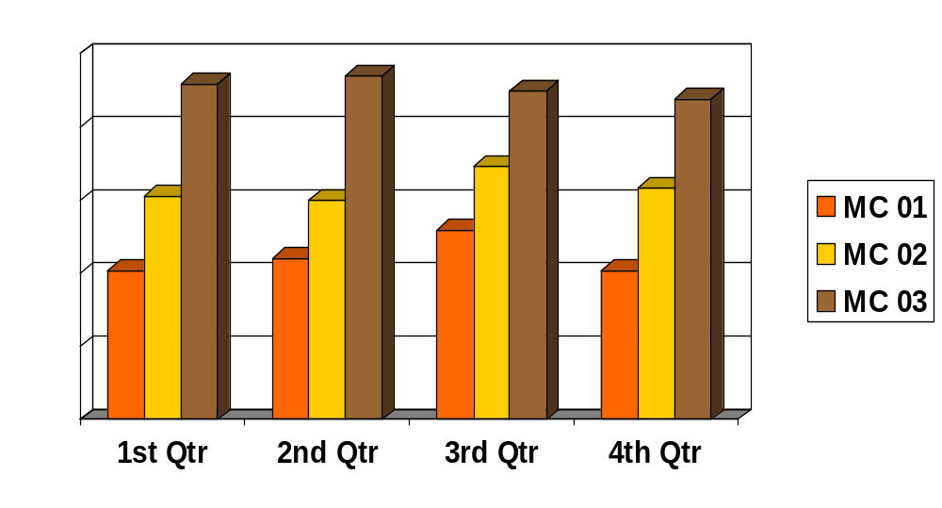
Chronic Problem
Types of Problems

Slide 23
Chronic Problem
Types of Problems
Always Occurring/ Existing
Generally Causes are Unknown and Plenty In Number and Interrelated
Not Accepted as a Problem
Chronic Problems are to be Tackled By Continual Improvement and Or Innovation

Slide 24
Types of Problems
Never Been There
Isolated Change
Problem Types
Recent Change
Excessive Variation

Slide 25
Juran’s Theory
All Problem Solving process passes through Two Journeys:
Juran’s
Theory
Journey 1
Journey 2
From Problem/ Symptom to the Cause
From the Cause to the Solution

Slide 26
Continual Improvement
Continually Improve the Effectiveness of QMS by
  Quality Policy
  Quality Objectives
  Audit results
  Analysis of data
  Corrective & Preventive Actions
  Management review
REQUIREMENTS

Slide 27
Corrective Action
Corrective Action
REQUIREMENTS
Appropriate
Effective
Eliminates Causes
Prevents recurrence

Slide 28
Corrective Action
Documented Procedure for Corrective Action
REQUIREMENTS
Should Cover
Review of NC
Determine the Causes
Evaluating the need for action
Determining and Implementing the action
Record the results of action
Review of the effectiveness of the action

Slide 29
Preventive Action
Preventive Action
REQUIREMENTS
Appropriate to the Effects of Potential Problems
Eliminates the cause of Potential NC
Prevents the occurrence

Slide 30
Preventive Action
Documented Procedure for Preventive Action
REQUIREMENTS
Should Cover
Determining the Potential NC and its Causes
Evaluating the Need for action to Prevent NC
Determining and Implementing the action
Recording the results of action
Reviewing effectiveness of the preventive action

Slide 31
Philosophy of Root Cause
Nobody wants to make a mistake
Everybody wants to do a good job
All Problems can be traced to system issues

Slide 32
Philosophy of Root Cause
No System
No Communication
System Issues
Not Suitable
Not Effective

Slide 33
Philosophy of Root Cause
System is the outcome of Policy
Policy also creates Environment
Good Policy creates good system
Good Policy creates good environment

Slide 34
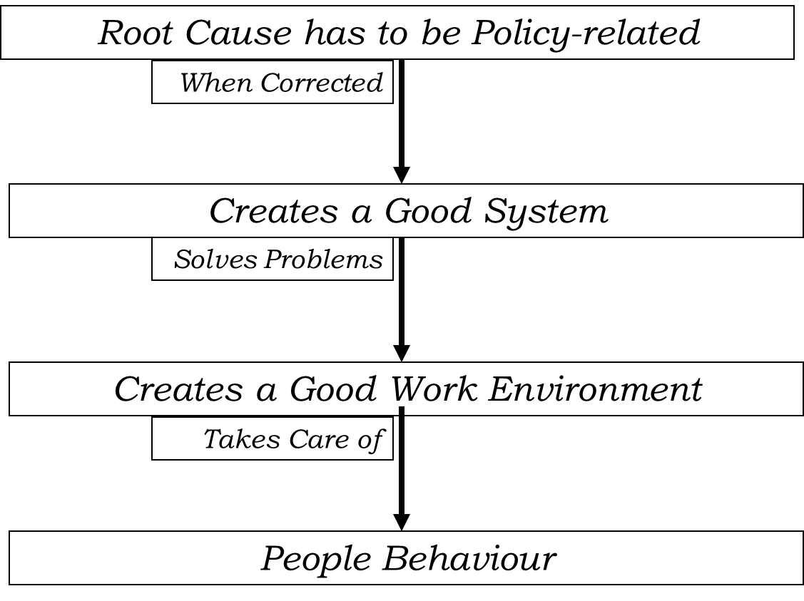
Philosophy of Root Cause

Slide 35
Identification of Root Cause
Cause and Effect Diagram
Master Cause Analysis
Why Why Analysis

Slide 36
Steps for Problem Solving
Problem Definition
Analyze process to determine root cause
Improve the process by attacking root causes -
Implementation of Actions
Control the improved process to hold gains -
Standardization and Sustenance of Results

Slide 37
Systematic Problem Solving
Understand and adopt a Systematic process and not trails
Focus on Root Causes not Symptoms
Present information clearly
Factual approach to Decision Making
Use of QC Tools
Complete PDCA approach

Slide 38


Steps for Problem Solving
what
Who
When
Determination
of The
Problem
(Define and Measure the
level of performance)
where
Why
How

Slide 39
Steps for Problem Solving
Problem Definition through 5W-2H Method
Questions
Answer
Example
Who is complaining?
Customer-Internal/External
Customer: ABC India Ltd
What is he complaining?
Nature of Complaint
Crank Shaft Diameter Not as per specification
Why he is complaining?
Problem Encountered
The Diameter is
Oversize by 0.02 mm and creating serious problem during assembly
When he is complaining?
Date on which Complaint raised
27/05/2015
Where he is complaining?
Plant/Division/
Location from where the Complaint is raised
ABC India Ltd.
Plant II –Gear Box Division
How?
Mode of Communication of the Complaint
Nonconformity Material Report Dt.27/05/2015
How much?
Quantity Affected
5 Nos. out of 1000 Nos.

Slide 40

Steps for Problem Solving
Formation of Cross Functional Team
Preparation of Time line for the Project
Quantify and Set SMART target
S –Specific
M- Measurable
A-Attainable
R-Relevant
T-Time Bound

Slide 41
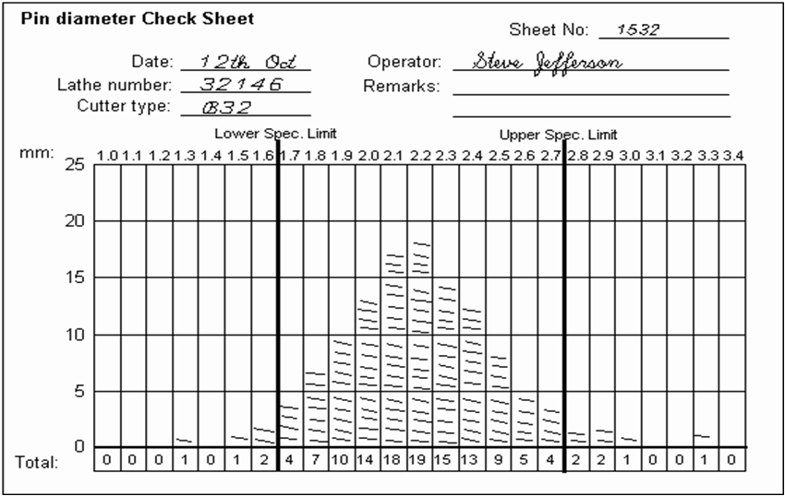
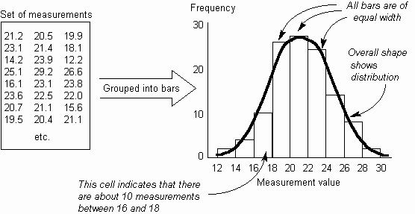
Steps for Problem Solving
Measure Level of Performance
Check Sheet
Histogram

Slide 42
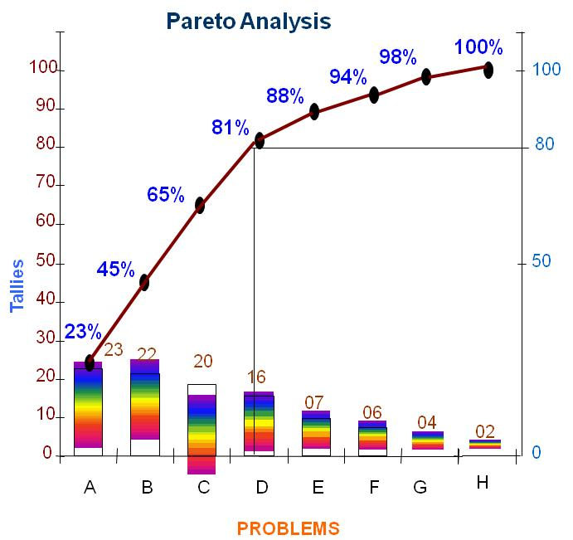
Steps for Problem Solving
Measure Level of Performance
Pareto Analysis
DETAILED PROCESS STUDY AND
PROCESS WALKTHOUGH
PROCESS MAP

Slide 43
Steps for Problem Solving
Containment
And
Short Term
Corrective Action

Slide 44
Containment / Disposition Action
Scrap
Use it for alternate
application
Correction
(Rework / Repair)
Action on Non Conforming Product
Accept under
concession
Internal
Authority
Customer

Slide 45
Types of Disposition
Point
Horizontal
Disposition
Types
Vertical
Parallel

Slide 46
Steps for Problem Solving
Analysis – Root Cause
Identification and Validation
      Cause and Effect Diagram
      Master Cause Analysis
      Why – Why Analysis

Slide 47
Steps for Problem Solving
Analysis – Root Cause
Identification and Validation
      Occur Root Cause
      Escape / Detection Root Cause
      Systemic Root Cause

Slide 48
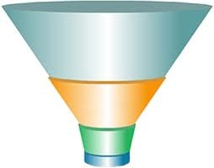
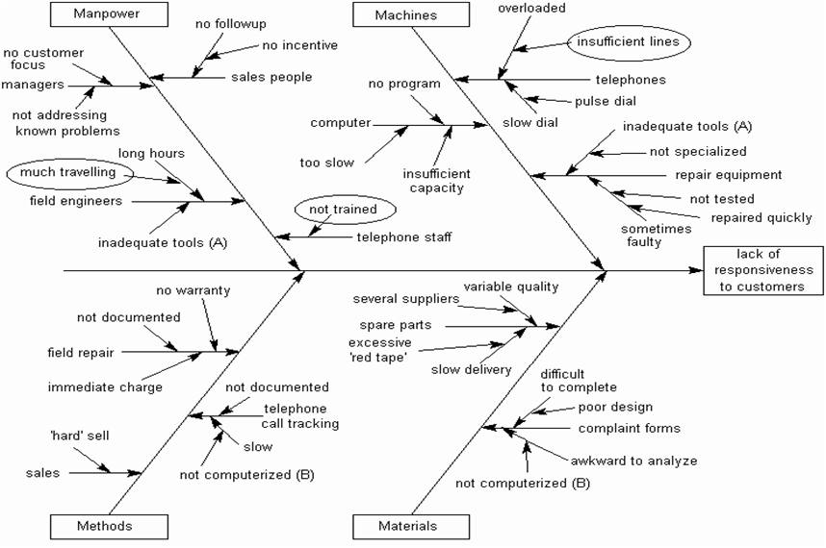
Steps for Problem Solving
Identify Possible Causes
Cause and effect Diagram

Slide 49
Master Cause Analysis
Sl.# | Cause | Is there a Spec. | If So what is the spec. | Basis for spec. | Is it checked & How? | What is the Actual | Is diff. Impor-tant? | Action Plan

Slide 50
WHY-WHY Analysis
Sl.# | Cause | WHY | WHY | WHY | WHY | WHY

Slide 51
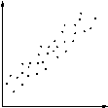
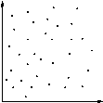
Scatter Diagram
Scatter Diagram -Use it when it is suspected that the variation of two items is connected in some way, to show any actual correlation between the two.
No relationship between two
elements under study
Relationship exists between two
elements under study.
Cause and Effect

Slide 52
Steps for Problem Solving
Identify
&
Evaluate the Solution

Slide 53
Steps for Problem Solving
Implement
The
Actions Decided

Slide 54


Steps for Problem Solving
Verification
For
Implementation
&
Effectiveness
( Improve- Action and Result Verification)

Slide 55
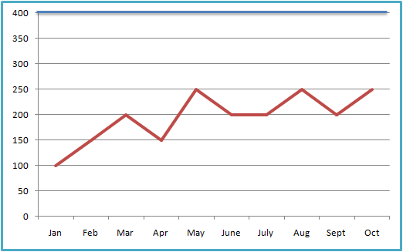
Steps for Problem Solving
Verification For Implementation
&
Effectiveness
( Improve- Action and Result Verification)
Target
Target
Before
After

Slide 56
Steps for Problem Solving
Prevent Recurrence
(Control-Standardization and Conclusion)

Slide 57

Steps for Problem Solving
Standardization and Conclusion
Poke-yoke
Audio-Visual Alarm/Buzzer
Check List
Visual Controls
Work Instructions/Standard Operating
procedures
Control Charts
Updation of Documents- Control Plan /FMEA
Communication, Training and Education
Consolidate Lessons Learnt
Check scope for Horizontal Deployment
Recognize the Team

Slide 58
Measurement
7 QC Tools
Check sheet
Histogram
Pareto diagram
Cause and effect diagram
Scatter diagram
Stratification
Graphs and control charts

Slide 59
7 QC
Problem Solving
Process Techniques
PROBLEM
5W-2H Stratification
Pareto chart
SYMPTOM
Check sheet
CAUSE
Cause &Effect
Cause Analysis table
WHY-WHY Analysis.
Scatter Diagram
REMEDY

Slide 60
Problem Solving
Process Techniques
Graphs and Control Charts
Histogram
Check sheet
EFFECTIVENESS
MONITOR

Slide 61
LIST OF 7 QC TOOLS
Check sheet
Histogram
Pareto diagram
Cause and effect diagram
Scatter diagram
Stratification
Graphs and control charts
7 QC TOOLS

Slide 62
WHEN TO USE IT
Use it when data is to be recorded manually, to ensure the
data is accurately recorded and is easy to use later, either
for direct interpretation or for transcription, for example
into a computer.
Use it when the recording involves counting, classifying,
checking or locating.
Use it when it is useful to check each measurement as it is
recorded, for example that it is within normal bounds.
Use it when it is useful to see the distribution of measures
as they are built up.
CHECK SHEET

Slide 63
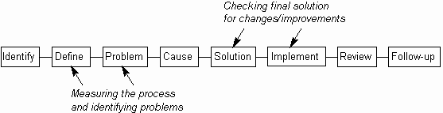
WHEN TO USE IT
CHECK SHEET

Slide 64
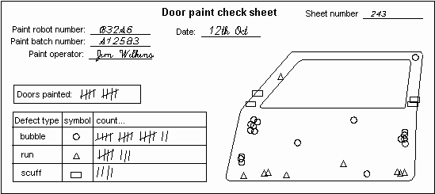
CHECK SHEET

Slide 65
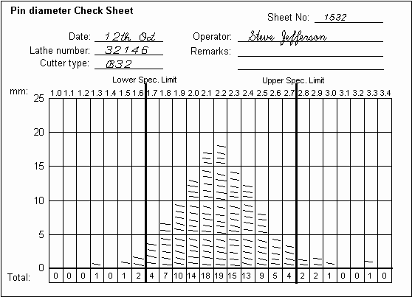
PROCESS DISTRIBUTION SHEET
CHECK SHEET

Slide 66
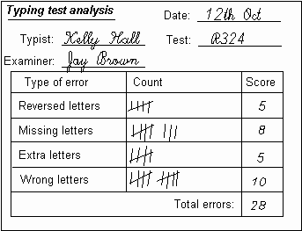
DEFECTIVE ITEM CHECHSHEET
CHECK SHEET

Slide 67
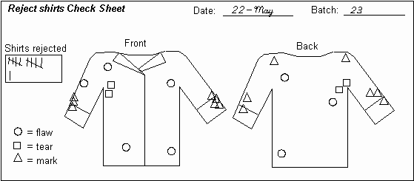
LOCATION PLOT
CHECK SHEET

Slide 68
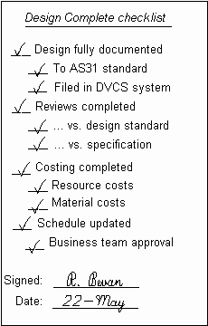
DESIGN CHECK LIST
CHECK SHEET

Slide 69
HISTOGRAM:WHEN TO USE IT
Use it to investigate the distribution of a set of
measurements.
Use it when it is suspected that there are multiple factors
affecting a process, to see if this shows up in the
distribution.
Use it to help define reasonable specification limits for a
process by investigating the actual distribution.
Use it when you want to see the actual shape of the
distribution, as opposed to calculating single figures like the
mean or standard deviation.
HISTOGRAM

Slide 70
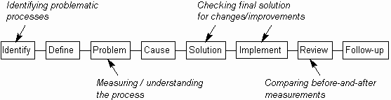
HISTOGRAM:WHEN TO USE IT
HISTOGRAM

Slide 71
HOW TO UNDERSTAND IT
The Histogram shows the frequency distribution across a set of measurements as a set of physical bars. The width of each bar is constant and represents a fixed range of measurements (called a cell, bin or class). The height of each bar is proportional to the number of measurements within that cell. Each bar gives a solid visual impression of the number of measurements in it and together the bars show the distribution across the measurement range.
HISTOGRAM

Slide 72
HOW TO UNDERSTAND IT
HISTOGRAM

Slide 73


HISTOGRAM PATTERN
HISTOGRAM PATTERN | SYMPTOM | POSSIBLE PROBLEM
 | Low with gaps | Bar range too narrow There is no continuous flow of data. This is an another version of plateau distribution
 | High with few bars | Could be extreme version of truncated distribution.
HISTOGRAM

Slide 74
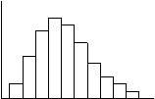

HISTOGRAM PATTERN
HISTOGRAM PATTERN | SYMPTOM | POSSIBLE PROBLEM
 | Skewed (this is positive; negative skew has tail to right) | Natural distribution (more variation in one direction) or incomplete data being used.
 | Exponential | Distribution is not bell-shaped (extreme version of skewed)
HISTOGRAM

Slide 75


HISTOGRAM PATTERN
HISTOGRAM PATTERN | SYMPTOM | POSSIBLE PROBLEM
 | Dual-peaked (bimodal) | Measurement is of two processes. This is very common, e.g. data from two periods, process changed mid-stream.
 | Isolated-peaked | Two processes being measured (well-separated bimodal distribution).
HISTOGRAM

Slide 76

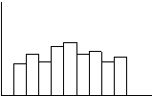
HISTOGRAM PATTERN
HISTOGRAM PATTERN | SYMPTOM | POSSIBLE PROBLEM
 | Cog-toothed (or Combed) | Faulty measurement, rounding error or version of plateau distribution
 | Plateau | Combination of multiple bell-shaped curves, extreme version of bimodal distribution (multiple processes) or faulty measurement
HISTOGRAM

Slide 77
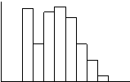
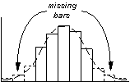
HISTOGRAM PATTERN
HISTOGRAM PATTERN | SYMPTOM | POSSIBLE PROBLEM
 | Edge-peaked | Modified data - often caused by shifting data that was out of specification back inside specification limits.
 | Truncated | Incompletely reported data or measured after inspection has rejected items outside specification limits.
HISTOGRAM

Slide 78
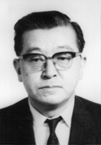
INTRODUCTION
“One of the greatest principles behind QC is consumer satisfaction. Within a company, the next process is the customer. If this way of thinking is driven home, the walls of sectionalism will crumble and fresh air will breeze through the company.”
- Dr. K. Ishikawa.
CAUSE-EFFECT DIAGRAM

Slide 79
WHEN TO USE IT
Use it when investigating a problem, to identify and select
key problem causes to investigate or address.
Use it when the primary symptom (or effect) of a problem is
known, but possible causes are not all clear.
Use it when working in a group, to gain a common
understanding of problem causes and their relationship.
Use it to find other causal relationships, such as potential
risks or causes of desired effects.
CAUSE-EFFECT DIAGRAM

Slide 80
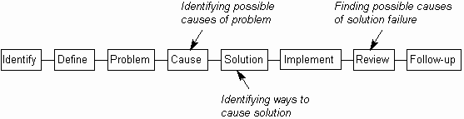
WHEN TO USE IT
CAUSE-EFFECT DIAGRAM

Slide 81
CAUSE-EFFECT DIAGRAM
Also known as an Ishikawa Diagram (after its originator, Kaoru Ishikawa, who first used in 1940s). It is also more popularly known as the Fishbone Diagram.
In essence, it is simply a tree or hierarchy, showing how causes have causes have causes. Its main use is to discover potential causes of unwanted problems. It also can be used more flexibly for such as discovering how to cause solutions
CAUSE-EFFECT DIAGRAM

Slide 82

CAUSE-EFFECT DIAGRAM
CAUSE-EFFECT DIAGRAM

Slide 83
CAUSE STUDY
MACHINE
CAUSE
MAN
CAUSE & EFFECT DIAGRAM
METHOD
MATERIAL

Slide 84
INTRODUCTION
The Pareto principle is to concentrate on “vital few” rather than “trivial many” in tackling quality problems. The Pareto diagram is a tool for identifying few actually important causes for defectives which result in large proportion of defectives, instead of concentrating on large number of causes which contributes to a small proportion of the total defectives.
PARETO ANALYSIS

Slide 85
WHEN TO USE IT
Use it when selecting the most important things on which
to focus, thus differentiating between the 'vital few' and the
'trivial many'.
Use it after improving a process, to show the relative
change in a measured item.
Use it when sorting a set of measurements, to visually
emphasize their relative sizes.
Use it, rather than a Bar Chart or Pie Chart to show the
relative priority of a set of numeric measurements
PARETO ANALYSIS

Slide 86
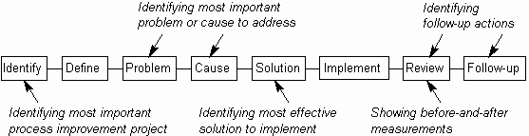
WHEN TO USE IT
PARETO ANALYSIS

Slide 87
CONSTRUCTING PARETO
A Pareto diagram is a bar chart of number of defectives with bars representing the number of defectives due to different sources arranged in descending order of their importance. A line graph of cumulative number of defectives (Ogive) is also drawn in the same chart. The defects are given along the x axis, the number of defects are given on the left y axis and the cumulative %defects is given along the right y axis.
PARETO ANALYSIS

Slide 88
EXAMPLE
The same details are shown in the form of a table and
Pareto diagram indicating the cumulative effect of the problem.
SL. NO
PROBLEMS
No.Of tallies
%
Cumulative %
1
Non availability of sparking machine at the right time.
23
23
23
2
High cost of the process.
22
22
45
3
Transport difficulties and job handling.
20
20
65
PARETO ANALYSIS
4
Not flexible for heavy jobs.
16
16
81
5
Frequent dismantling of the tool.
07
07
88
6
Long processing time.
06
06
94
7
Lack of skill.
04
04
98
8
02
02
100
Material composition

Slide 89
EXAMPLE
A- Non availability of sparking machine at the right time.
B- High cost of the process.
C- Transport difficulties and job handling.
D- Not flexible for heavy jobs.
E- Frequent dismantling of the tool.
F-Long processing time.
G- Lack of skill.
H- Material composition.
Pareto Analysis
98%
100%
100
94%
100
90
88%
81%
80
80
70
65%
60
Cumulative %age
50
45%
50
PARETO DIAGRAM
Tallies
40
30
23%
23
22
20
20
16
10
07
06
04
02
0
0
A
B
C
D
E
F
G
H
PROBLEMS

Slide 90
WHEN TO USE IT
Use it when it is suspected that the variation of two
items is connected in some way, to show any actual
correlation between the two.
Use it when it is suspected that one item may be causing
another, to build evidence for the connection between
the two.
Use it only when both items being measured can be
measured together, in pairs
SCATTER DIAGRAM

Slide 91
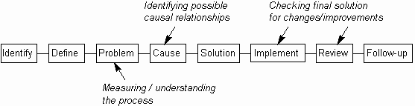
WHEN TO USE IT
SCATTER DIAGRAM

Slide 92
REASONS FOR USING SCATTER DIAGRAM
A Scatter Diagram shows correlation between two items for three reasons:
There is a cause and effect relationship between the two
measured items, where one is causing the other (at least in part).
2. The two measured items are both caused by a third item. For example, a Scatter Diagram which shows a correlation between cracks and transparency of glass utensils because changes in both are caused by changes in furnace temperature.
3. Complete coincidence. It is possible to find high correlation of unrelated items, such as the number of ants crossing a path and newspaper sales.
SCATTER DIAGRAM

Slide 93
REASONS FOR USING SCATTER DIAGRAM
Scatter Diagrams may thus be used to give evidence for a cause and effect relationship, but they alone do not prove it. Usually, it also requires a good understanding of the system being measured, and may required additional experiments.
SCATTER DIAGRAM

Slide 94
1.Determine the two items that you wish to compare. One
may be identified as the suspected cause and the other as
the suspected effect. This may come from the use of
other tools, such as a Cause-Effect Diagram or Relations
Diagram
2. Identify the measurements to be taken. Both must be
variables (i.e. measurable on a continuous scale) and it
must be possible to measure both at the same time.
SCATTER DIAGRAM

Slide 95
3. Make 50 to 100 pairs of measurements. When doing
this, aim to keep all other variables as steady as possible,
as they could interfere with the final figures
4. Plot the measured pairs on the Scatter Diagram. Design
the axes and scales on the diagram to give the maximum
visual spread of points. This may involve using different
scales and making the axes cross at non-zero values
SCATTER DIAGRAM

Slide 96
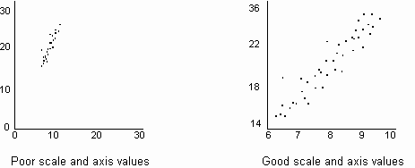
SCATTER DIAGRAM

Slide 97
5. If the correlation is high, a regression ('average') line
may be drawn through the plotted points, to emphasize
the trend.
6. If the correlation is reasonably linear, then a
correlation coefficient may be calculated.
7. Interpret the diagram and act accordingly
SCATTER DIAGRAM

Slide 98
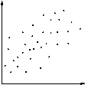
DEGREE OF CORRELATION
SCATTER DIAGRAM | DEGREE OF CORRELATION | INTERPRETATION
 | None | No relationship can be seen. The 'effect' is not related to the 'cause' in any way.
 | Low | A vague relationship is seen. The 'cause' may affect the 'effect', but only distantly. There are either more immediate causes to be found or there is significant variation in the 'effect'.
SCATTER DIAGRAM

Slide 99
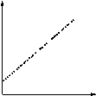
DEGREE OF CORRELATION
SCATTER DIAGRAM | DEGREE OF CORRELATION | INTERPRETATION
 | High | The points are grouped into a clear linear shape. It is probable that the 'cause' is directly related to the 'effect'. Hence, any change in 'cause' will result in a reasonably predictable change in 'effect'.
 | Perfect | All points lie on a line (which is usually straight). Given any 'cause' value, the corresponding 'effect' value can be predicted with complete certainty.
SCATTER DIAGRAM

Slide 100
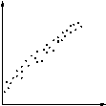
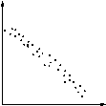
TYPE OF CORRELATION
SCATTER DIAGRAM | TYPE OF CORRELATION | INTERPRETATION
 | Positive | Straight line, sloping up from left to right. Increasing the value of the 'cause' results in a proportionate increase in the value of the 'effect'.
 | Negative | Straight line, sloping down from left to right. Increasing the value of the 'cause' results in a proportionate decrease in the value of the 'effect'.
SCATTER DIAGRAM

Slide 101
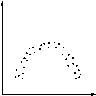
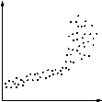
TYPE OF CORRELATION
SCATTER DIAGRAM | TYPE OF CORRELATION | INTERPRETATION
 | Curved | Various curves, typically U- or S-shaped. Changing the value of the 'cause' results in the 'effect' changing differently, depending on the position on the curve.
 | Part linear | Part of the diagram is a straight line (sloping up or down). May be due to breakdown or overload of 'effect', or is a curve with a part that approximates to a straight line (which may be treated as such).
SCATTER DIAGRAM

Slide 102
SCATTER DIAGRAM
Variable 2
SCATTER DIAGRAM
Variable 1

Slide 103
DEGREE OF CORRELATION
The correlation coefficient gives a numerical value to the degree of correlation. This will vary from -1, which indicates perfect negative correlation, through 0, which indicates no correlation at all, to +1, which indicates perfect positive correlation. Thus the closer the value is to plus or minus 1, the better the correlation. In a perfect correlation, all points lie on a straight line.
A regression line forms the 'best fit' or 'average' of the plotted points. It is equivalent to the mean of a distribution
SCATTER DIAGRAM

Slide 104
WHEN TO USE IT
Use when investigating a process, to determine whether it
is in a state of statistical control and thus whether actions
are required to bring the process under control.
Use it to differentiate between special and common causes
of variation, identifying the special causes which need to
be addressed first.
Use it to detect statistically significant trends in
measurements; for example, to identify when and by how
much a change to the process has improved it
CONTROL CHART

Slide 105
WHEN TO USE IT
Use it as an ongoing 'health' measure of a process, to
help spot problems before they become significant.
It is only practical to use it when regular measurements
of a process can be made. Typically this is in processes
that repeat within a reasonably short space of time.
CONTROL CHART

Slide 106
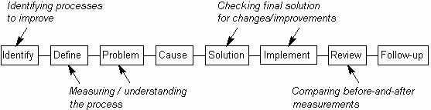
WHEN TO USE IT
CONTROL CHART

Slide 107
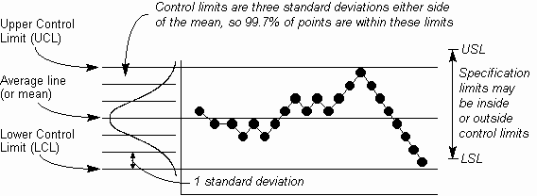
HOW TO UNDESTAND IT
CONTROL CHART

Slide 108
HOW TO UNDESTAND IT
In many cases, quality is influenced by multiple elements. Compounding of the effects of these elements makes it difficult to find our the clear relationship between each element and quality, namely causes and results. In such a case, the technique of stratification is often found to be effective.
For instance, to find out the cause of product defects, data is collected separately in accordance with raw materials, specifications of finished products, workers, or time. The technique of data taking based on segregated elements is called “Stratification”.
STRATIFICATION

Slide 109
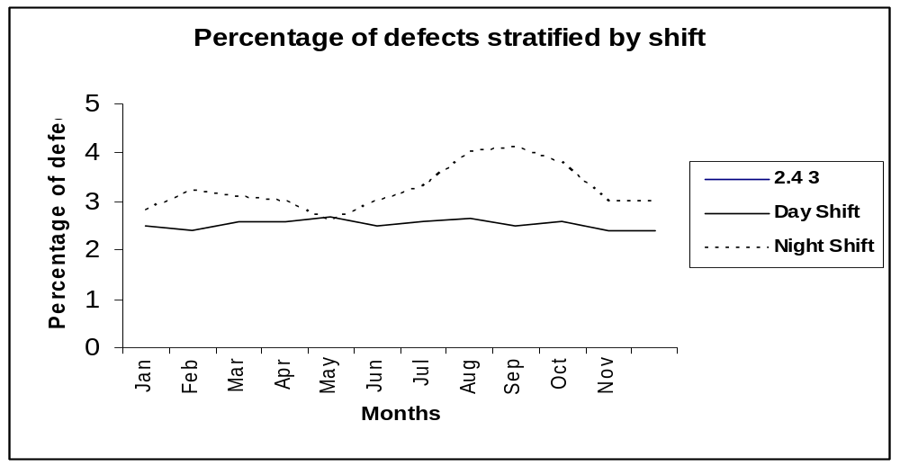
HOW TO UNDESTAND IT
Percent of defects stratified by types of problems
STRATIFICATION

Slide 110
7 QC
Process Techniques
PROBLEM
5W-2H Stratification
Pareto chart
SYMPTOM
Check sheet
CAUSE
Cause &Effect
Cause Analysis table
WHY-WHY Analysis.
Scatter Diagram
REMEDY

Slide 111
Process Techniques
Graphs and Control Charts
Histogram
Check sheet
EFFECTIVENESS
MONITOR

Slide 112

THANK YOU

